Slide 1
Implementation of Parallel Computation of Multiple Subgame Perfect Equilibrium in N-Player Role-Playing Games
Geela Margo Ramos
COP4520 Semester Project

Slide 2
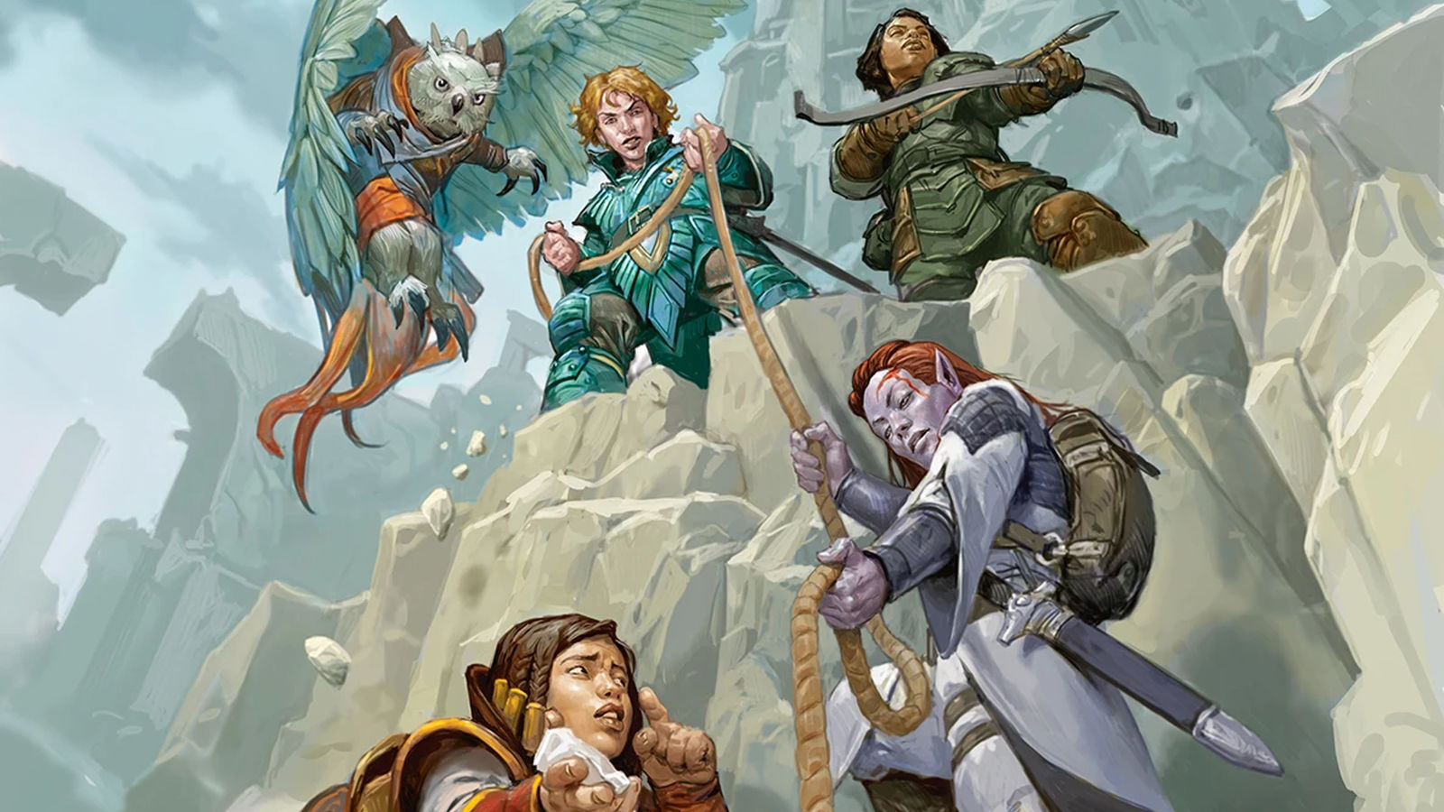
Table of Contents
Section I: Introduction to Game Theory
First, we’ll review the basic concepts that this project covers, including Nash Equilibrium, Subgame Perfect Nash Equilibrium, Escalation, and Back Induction.
Section II: Project Overview and Breakdown
Then, we’ll cover how Nash Equilibrium plays a role in role-playing games, and breakdown of initial approach applied to calculating it throughout the game.
Section III: Current Research in Nash Equilibrium Applications
Finally, we’ll take a look at the challenges faced with the approach, and how current research in other Nash Equilibrium applications can address these obstacles.

Slide 3
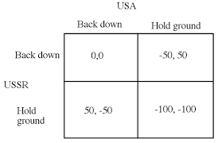
What is game theory?
Branch of mathematics concerned with the analysis of strategies for dealing with competitive situations where the outcome of a participant’s choice of action depends critically on the actions of other participants
Applications: War, Business, and Biology
There are 5 different types of games we can investigate under game theory:
Cooperative and Non-Cooperative
Normal Form and Extensive Form Games
Simultaneous Move Games and Sequential Move Games
Constant Sum, Zero Sum, and Non-Zero Sum Games
Symmetric and Asymmetric Games
Notes:
*After reading definition* Another way to say this is game theory is how we calculate a player’s choice of action based on its dependencies to the possible actions another participant might choose from. For example, it is most likely that if I know “in advance” my teacher will assign an exam next class, I will make sure to study before class starts. Game theory begins as we continue to introduce more strategies and more players in the scenario we are observing, and as a result, it can be applied in other ways. When we think of war, for instance, game theory has been used to create an analysis of the Cuban Missile Crisis.
There are five different types of games, and you’ll notice that different aspects of these categories can be drawn to aspects of role-playing games. The first is cooperative and non-cooperative games; cooperative games are where players are convinced to adopt a particular strategy through negotiation and agreement. We will look at this type of game in the Prisoner’s Dilemma in just a moment.
There is then, normal form and extensive form games. These are games where payoff and strategy can be formalized into different data structures. Specifically, a normal form game is where a matrix can be used to demonstrate the strategies adopted by different players of the game and their possible outcomes. Extensive form games host their description in the form of a decision tree. These help in the representation of events that can occur by chance. We will be exploring both types of games in this research.
Simultaneous move games and sequential games involve how movement occurs. Moving to the fourth type of game, these refer to how the sum of outcomes for all players can differ throughout game play. Finally, in the fifth type of game, symmetric games refer to when strategies adopted by all players are the same, whereas asymmetric games refer to when strategies adopted by players are different.
Thinking of the objective of this research, we can first and foremost define the nature of a role-playing game to be non-cooperative. Each player works towards their own goal, and they may also lack any incentive to change their strategy. When trying to model the dynamics of such a game, we can look to Nash Equilibrium to help us make the best decisions.

Slide 4
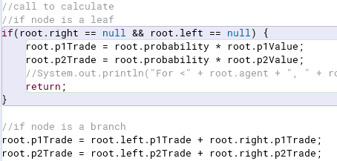
What is Nash Equilibrium?
A concept that determines the optimal solution a non-cooperative game
A player does not gain anything from deviating form their initially chosen strategy
Games can include multiple Nash equilibria or none of them
Mixed Strategy Nash Equilibrium: One player playing a randomized strategy and no player being able to increase his/her expected payoff by playing an alternate strategy
Pure strategy is not available
Meant to be “unpredictable”
Randomizing and mixing strategies will allow for a player to avoid exploitation
Can be calculated through specified probabilities for each action to be chosen
Notes:
Note: In role-playing games, especially when objectives can be achieved through more than one method, calculating for mixed strategy Nash Equilibrium.

Slide 5
Project Overview and Breakdown

Slide 6
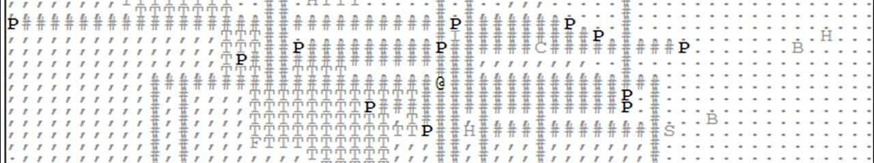
Simulation Foundations
Game Play:
You become the “player.” A total of n-number of enemies will can be chosen, to set the difficulty of the game. Each start with a total of 20 health.
Actions will be provided as you traverse a map, working towards your objective.
Interactive Interface:
Inspiration for the interface comes from the open-source, text-based game “A Dark Room.”
Part of the game play in “A Dark Room” is to traverse a map, which provide the chance for encounters and looting for resources.
Objectives for the Game:
For the Player: To win the game, you must find “The Institute.” You can also win the game by destroying all enemies you face.
For the Enemy: To beat the player, an enemy must successfully defeat the player by finding them and depleting their health in chance encounters.

Slide 7
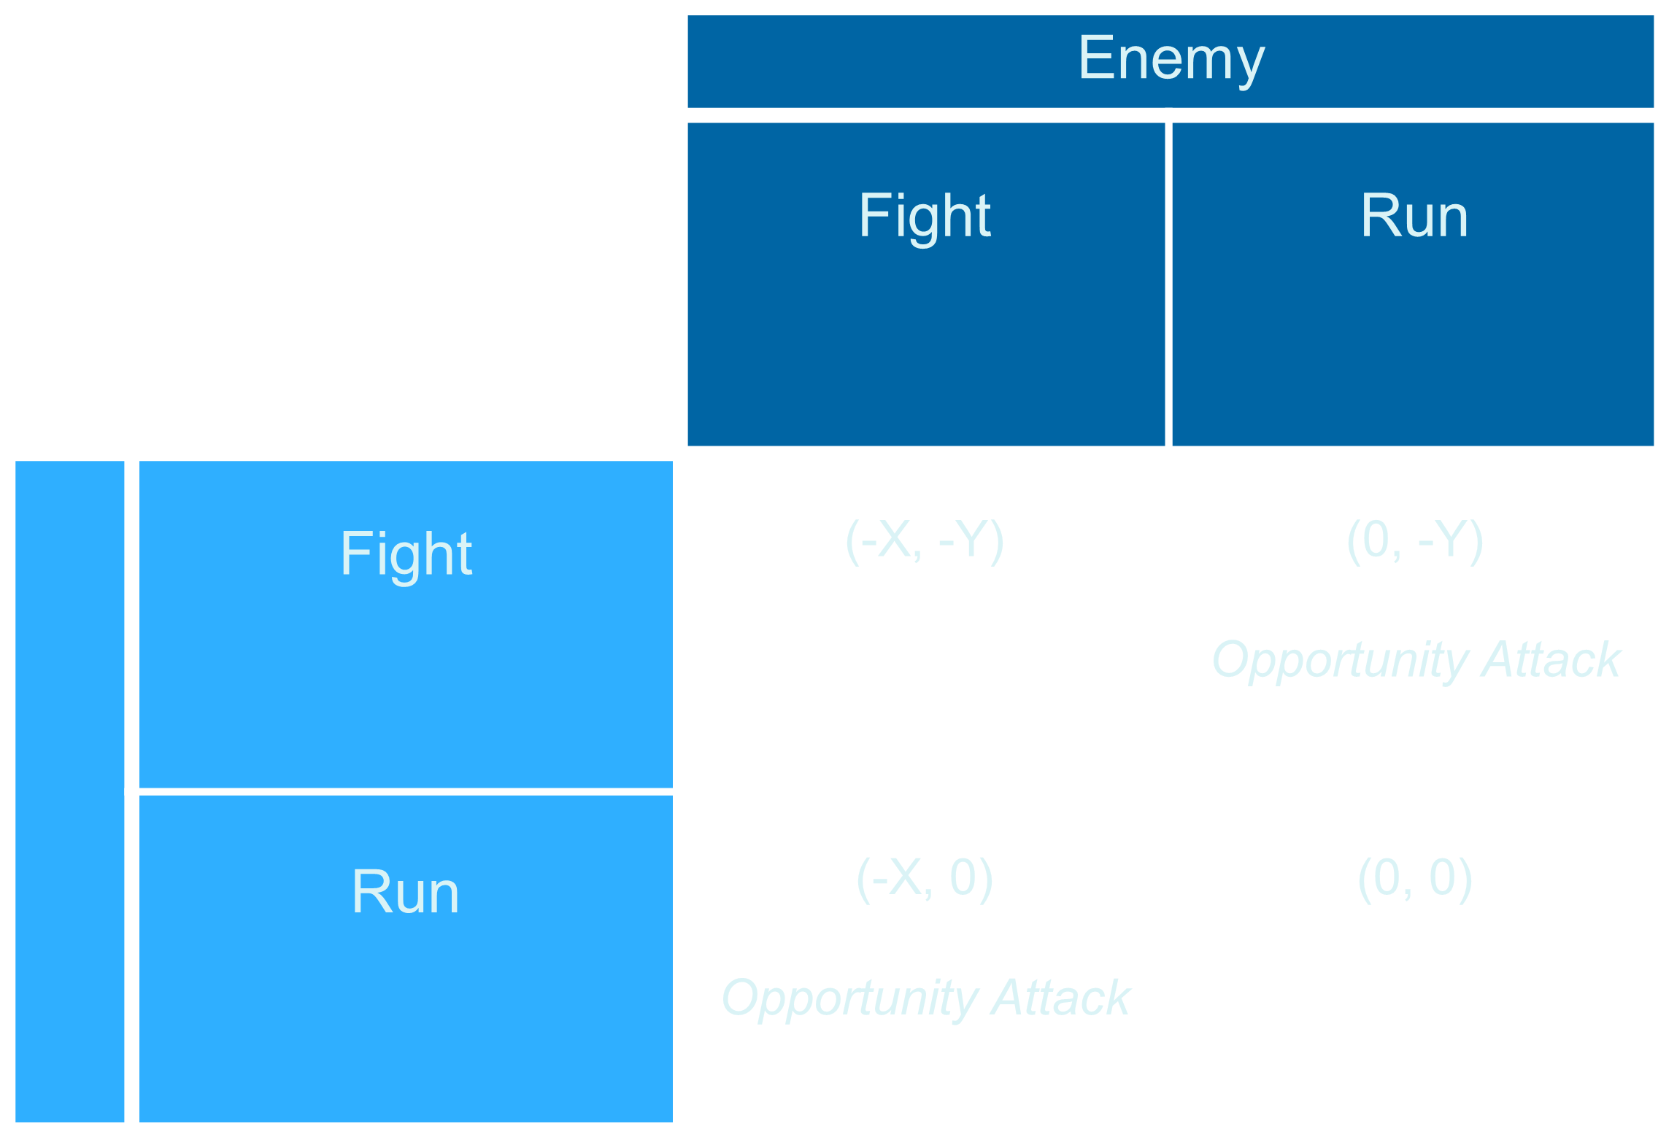
Chance Encounter
Important Details About Chance Encounters:
<Fight, Fight> Scenarios will incur damage equal to rolling a 6-sided dice.
<Fight, Run> or <Run, Fight> Scenarios will incur damage equal to rolling a 4-sided dice.
<Run, Run> Scenarios incur no damage to either player.
During chance encounters, both “agents” will have to roll a 20-sided dice for initiative.
Player

Slide 8
Escalation Throughout Game
Player “makes enough noise” for the enemy to notice.
Enemy attempts to “dash” to move closer to the player.
Player attempts to find “armor” for possible chance encounter.
(2 + X, 2 + Y)
Player
Fast Pace
Enemy
Search
Player
Loot
Slow Pace
Wait
Rest
Since movement is variable, chance encounters can happen at stage two or three for each minute of the game.
(0, 0)
(2, 1)
(2, 2)

Slide 9
Escalation Throughout Game: The Multiple Subgames Problem
(0, 0)
Player
Fast Pace
Slow Pace
Enemy
Important Details About Escalation:
Trade-off is considered the number of spaces an agent moves closer to their target.
Chance Encounter is factored into leaves 1, 3, 4 of the tree, as it is up to the enemy to engage in the encounter.
Leaf 1
Wait
Search
Leaf 4
(2, 1) + <CE>
(2, 2) + <CE>
Player
Wander
Rest + CE
(2, 1)
(2 + X, 2 + Y) + <CE>
Leaf 2
Leaf 3
HIde
Loot + CE

Slide 10
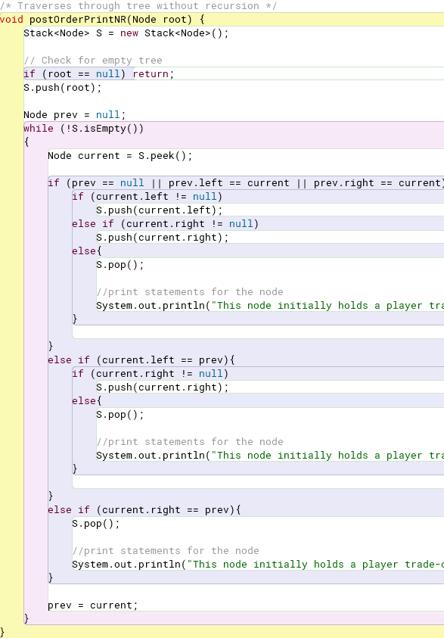
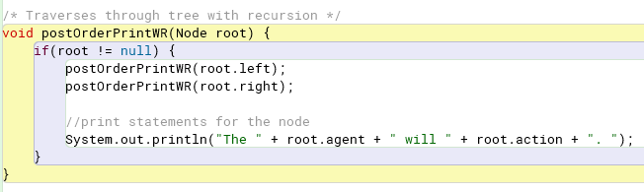
Architecture Breakdown: Initial Approach
The multiple subgames problem introduces (binary) game trees. We must conduct tree traversal.
Iterative/No Recursion
Recursive

Slide 11
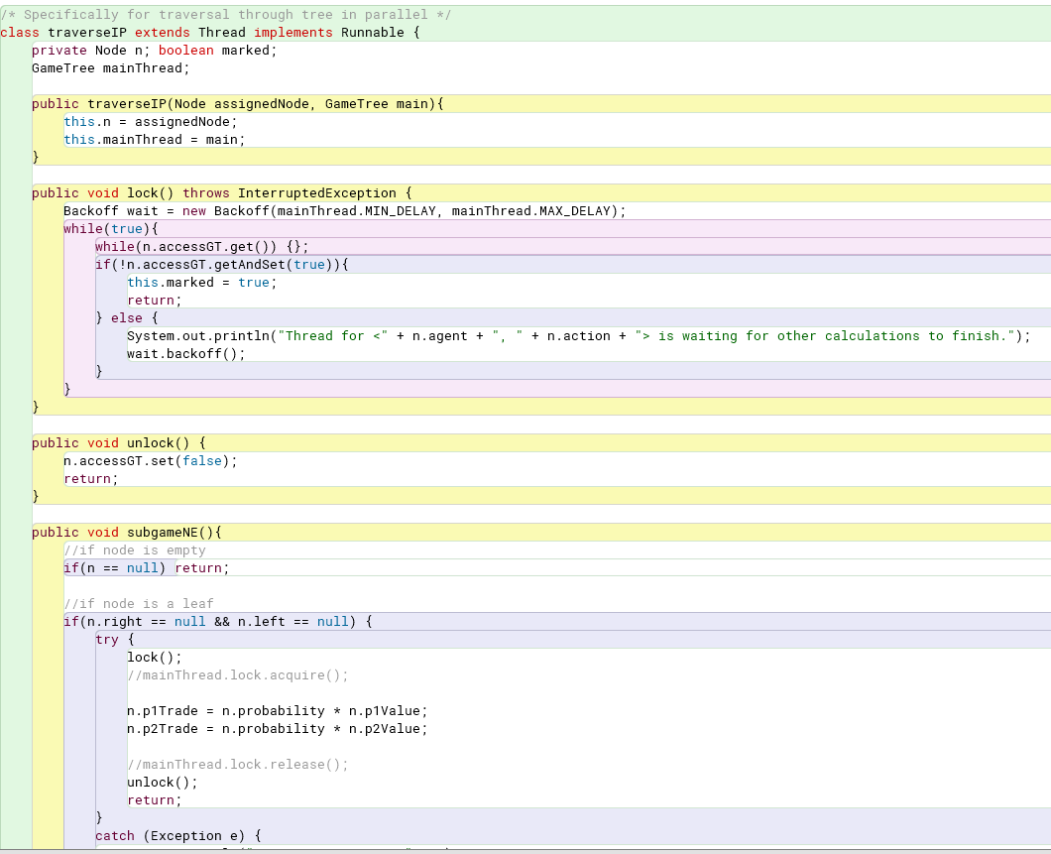
Initial Approach Evaluation
Initial Approach:
Nodes were assigned separate threads to conduct calculation for mixed-strategy perfect equilibria.
Post-order is used for method calls, since calculations are dependent on children nodes’ trade-off values.
Two methods were attempted:
Applying a Semaphore lock to the overall tree as each node conducts calculation
Applying the exponential backoff method to individual nodes as each node conducts calculation

Slide 12
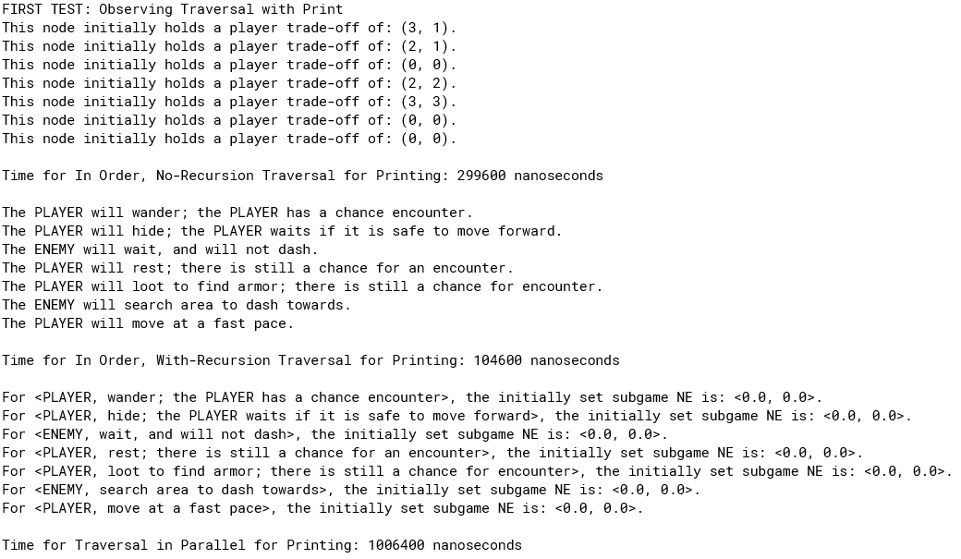
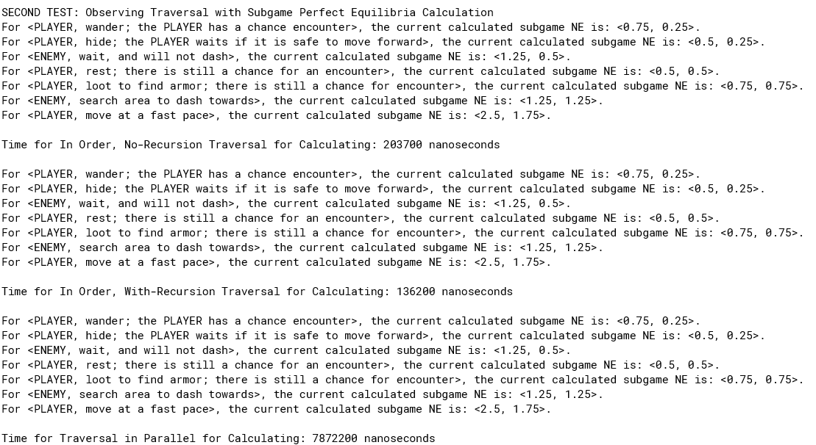
Initial Approach Evaluation
 | Iterative | Recursive | Parallel: Exponential Backoff | Parallel: Semaphore Lock
Task 1: Printing Information from the Node | Above 200,000 nanoseconds | Averaging 81,000 nanoseconds | Above 800,000 nanoseconds | Above 700,000 nanoseconds
Task 2: Subgame Perfect Equilibria Calculation | Averaging 7,700 nanoseconds | Averaging 2,800 nanoseconds | Above 600,000 nanoseconds | Averaging 51,000 nanoseconds

Slide 13
Challenges and Current Research in Nash Equilibrium Applications
What are the challenges to applying Nash Equilibrium to N-Player games and what is the potential of its application?

Slide 14
Challenge 1: How do we achieve better efficiency with Multiple Subgame Perfect Equilibria on a game tree?

Slide 15
Current Research Provides…
Multithread Pruned Tree Search in Distributed Systems – Yaoqing Gao and T.A. Marsland, University of Alberta
Efficiency of Parallel Minimax Algorithm for Game Tree Search – Plamenka Borovska, Milena Lazarova
Pruning of a game tree involves ignoring subtrees that cannot affect the final value of the root node
Window partitioning: Search window is divided into a number of disjoint segments
Tree splitting: Select nodes are split and assigned to different processors
Special hardware is used to generate and evaluate nodes in parallel
Recursive algorithm for finding the next move of a given player, determining all possible continuations of a game to the desired level
Amount of work generated increases exponentially given the depth of the tree
Search is restricted through alpha-beta cutoffs
Parallel implementation involves partitioning of sub-trees and assigning to multiple processors for searching

Slide 16
Challenge 2: How do you extend the calculation algorithm to calculate an optimal outcome when there are n-number of players or k-number of strategies?

Slide 17
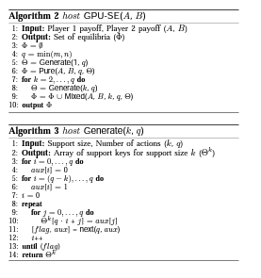
Current Research Provides…
Parallel Computation of Nash Equilibria in N-Player Games – Jonathan Widger, Daniel Grosu, Wayne State University
For an n-k game, such that n represents the number of players and k represents the number of pure strategies:
Systems of multilinear equations can be built to solve for Nash Equilibrium
Sequential Application: Enumerate all possible totally mixed strategy profiles, while checking if a Nash Equilibrium exists
Parallel Algorithm: Mixed strategy profiles are processed independently
Combinations of players and pure strategies are constrained by the maximum number of totally mixed equilibria supported by an n-k game

Slide 18
Future Work and Investigation
Application of the Minimax Algorithm
Experimental Evaluation Over an Extended Game
Final Development of the Simulation and Interface
Introduce dynamic probability to require re-calculation of Nash Equilibrium over duration of the game

Slide 19
Questions?
Thank you so much for listening to this presentation!

Slide 21
Implementation of Parallel Computation of Multiple Subgame Perfect Equilibrium in N-Player Role-Playing Games
Geela Margo Ramos
COP4520 Semester Project

Slide 22
Table of Contents
Section I: Introduction to Game Theory
First, we’ll review the basic concepts that this project covers, including Nash Equilibrium, Subgame Perfect Nash Equilibrium, Escalation, and Back Induction.
Section II: Project Overview and Breakdown
Then, we’ll cover how Nash Equilibrium plays a role in role-playing games, and breakdown of initial approach applied to calculating it throughout the game.
Section III: Current Research in Nash Equilibrium Applications
Finally, we’ll take a look at the challenges faced with the approach, and how current research in other Nash Equilibrium applications can address these obstacles.

Slide 23
Introduction
“We’ve come from far away, we landed here by fate. And all our deeds and ventures will astound with tellings great. Imagine, if you will, that you have arrived in the middle of a vast desert. Filled with hungry beasts, and ruins lost by time, you know you’re looking for ‘The Institute’ – a place of ancient magic that can help you achieve your dreams of mighty reign over the creatures that freely roam.”
“We thus begin the first page of your tale – of your tome. Find your target, but beware. There are also monsters that are seeking you and call this place home.”
Notes:
A large part of this research was inspired by first exposures to role-playing games like DnD; with a separate interest in game theory, I thought it would be fun to research the application of game theory in role-playing games. For example, how do we develop game dynamics and economical systems, especially for when there are games like Dnd, where the role of the Dungeon Master is to guide all “agents” (which includes players and opponents) in such a way that maximizes trade-off of one another. When done effectively, we can create a session that is fun, fair, and as challenging as the player would like it to be. However, to understand how we create the “thinking processes” through code – and what eventually leads into the MMORPGs – we need to first explore some concepts in game theory.

Slide 24
Introduction to Game Theory
What is Nash Equilibrium and what is its potential role
In role-playing games?

Slide 25
What is game theory?
Branch of mathematics concerned with the analysis of strategies for dealing with competitive situations where the outcome of a participant’s choice of action depends critically on the actions of other participants
Applications: War, Business, and Biology
There are 5 different types of games we can investigate under game theory:
Cooperative and Non-Cooperative
Normal Form and Extensive Form Games
Simultaneous Move Games and Sequential Move Games
Constant Sum, Zero Sum, and Non-Zero Sum Games
Symmetric and Asymmetric Games
Notes:
*After reading definition* Another way to say this is game theory is how we calculate a player’s choice of action based on its dependencies to the possible actions another participant might choose from. For example, it is most likely that if I know “in advance” my teacher will assign an exam next class, I will make sure to study before class starts. Game theory begins as we continue to introduce more strategies and more players in the scenario we are observing, and as a result, it can be applied in other ways. When we think of war, for instance, game theory has been used to create an analysis of the Cuban Missile Crisis.
There are five different types of games, and you’ll notice that different aspects of these categories can be drawn to aspects of role-playing games. The first is cooperative and non-cooperative games; cooperative games are where players are convinced to adopt a particular strategy through negotiation and agreement. We will look at this type of game in the Prisoner’s Dilemma in just a moment.
There is then, normal form and extensive form games. These are games where payoff and strategy can be formalized into different data structures. Specifically, a normal form game is where a matrix can be used to demonstrate the strategies adopted by different players of the game and their possible outcomes. Extensive form games host their description in the form of a decision tree. These help in the representation of events that can occur by chance. We will be exploring both types of games in this research.
Simultaneous move games and sequential games involve how movement occurs. Moving to the fourth type of game, these refer to how the sum of outcomes for all players can differ throughout game play. Finally, in the fifth type of game, symmetric games refer to when strategies adopted by all players are the same, whereas asymmetric games refer to when strategies adopted by players are different.
Thinking of the objective of this research, we can first and foremost define the nature of a role-playing game to be non-cooperative. Each player works towards their own goal, and they may also lack any incentive to change their strategy. When trying to model the dynamics of such a game, we can look to Nash Equilibrium to help us make the best decisions.

Slide 26
What is Nash Equilibrium?
A concept that determines the optimal solution a non-cooperative game
A player does not gain anything from deviating form their initially chosen strategy
Games can include multiple Nash equilibria or none of them
Mixed Strategy Nash Equilibrium: One player playing a randomized strategy and no player being able to increase his/her expected payoff by playing an alternate strategy
Pure strategy is not available
Meant to be “unpredictable”
Randomizing and mixing strategies will allow for a player to avoid exploitation
Can be calculated through specified probabilities for each action to be chosen
Notes:
Note: In role-playing games, especially when objectives can be achieved through more than one method, calculating for mixed strategy Nash Equilibrium.

Slide 27
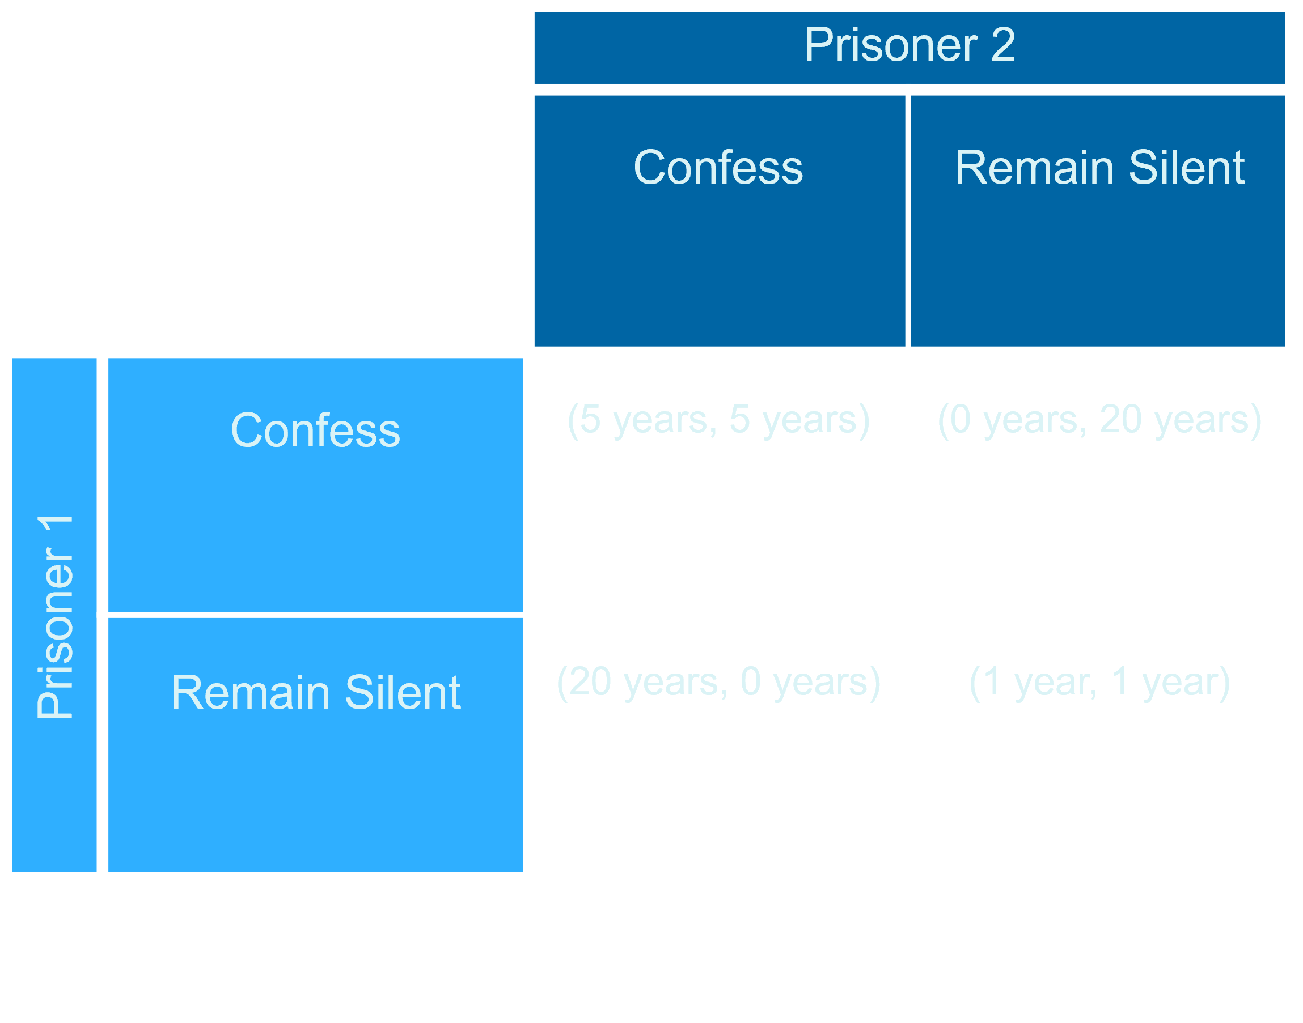
Example 1: The Prisoner’s Dilemma
Notes:
The Prisoner’s Dilemma is a sample of different types of games:
Cooperative Game, Symmetric Game, Normal Form Game, and Sequential Moves Game

Slide 28
What is Subgame Perfect Equilibrium?
A refinement of a Nash equilibrium, used in dynamic games
Requires that all threats are credible – repercussions or losses that might occur due to the responding person’s choice of action
Involves a finite extensive game, consisting of subgames such the players’ behavior from a point onward should represent a Nash equilibrium of the continuation game
Extensive form games use backward induction to solve for Nash equilibrium
Notes:
Process of reasoning backwards in time, from the end of a problem to a situation, to determine a sequence of optimal actions

Slide 29
Example 2: Firm Investment
(0, 0)
Firm 1
In
Firm 2
War
Out
Accept
(2, 2)
(3, 1)
Nash Equilibria for this Scenario:
<Out, In> ; <Accept>
Notes:
Firm Investments is a sample of an extensive form game.

Slide 30
Example 3: Going to War
(-10, -10)
Country A
Threaten
Country B
Escalate
Country A
War
Accept
Concede
Back down
(0, 0)
(5, -15)
(-15, 5)
Nash Equilibria for this Scenario:
<Accept, War> ; <Escalate>
Notes:
Looking at Example 3, this is often called an escalation of a game. These are best seen in crisis scenarios, players are assumed to have escalated their conflict and desire to stabilize it before it explodes. An increased threat is presented for consideration.

Slide 31
Project Overview and Breakdown

Slide 32
Simulation Foundations
Game Play:
You become the “player.” A total of n-number of enemies will can be chosen, to set the difficulty of the game. Each start with a total of 20 health.
Actions will be provided as you traverse a map, working towards your objective.
Interactive Interface:
Inspiration for the interface comes from the open-source, text-based game “A Dark Room.”
Part of the game play in “A Dark Room” is to traverse a map, which provide the chance for encounters and looting for resources.
Objectives for the Game:
For the Player: To win the game, you must find “The Institute.” You can also win the game by destroying all enemies you face.
For the Enemy: To beat the player, an enemy must successfully defeat the player by finding them and depleting their health in chance encounters.

Slide 33
Chance Encounter
Important Details About Chance Encounters:
<Fight, Fight> Scenarios will incur damage equal to rolling a 6-sided dice.
<Fight, Run> or <Run, Fight> Scenarios will incur damage equal to rolling a 4-sided dice.
<Run, Run> Scenarios incur no damage to either player.
During chance encounters, both “agents” will have to roll a 20-sided dice for initiative.
Player

Slide 34
Chance Encounter
First in Initiative
Fight
Run
Second in Initiative
Fight
Run
Fight
Run
Player
(-X, -Y)
(-X, 0)
(0, -Y)
(0, 0)

Slide 35
Escalation Throughout Game
Player “makes enough noise” for the enemy to notice.
Enemy attempts to “dash” to move closer to the player.
Player attempts to find “armor” for possible chance encounter.
(2 + X, 2 + Y)
Player
Fast Pace
Enemy
Search
Player
Loot
Slow Pace
Wait
Rest
Since movement is variable, chance encounters can happen at stage two or three for each minute of the game.
(0, 0)
(2, 1)
(2, 2)

Slide 36
Escalation Throughout Game: The Multiple Subgames Problem
(0, 0)
Player
Fast Pace
Slow Pace
Enemy
Important Details About Escalation:
Trade-off is considered the number of spaces an agent moves closer to their target.
Chance Encounter is factored into leaves 1, 3, 4 of the tree, as it is up to the enemy to engage in the encounter.
Leaf 1
Wait
Search
Leaf 4
(2, 1) + <CE>
(2, 2) + <CE>
Player
Wander
Rest + CE
(2, 1)
(2 + X, 2 + Y) + <CE>
Leaf 2
Leaf 3
HIde
Loot + CE

Slide 37
Architecture Breakdown: Initial Approach
The multiple subgames problem introduces (binary) game trees. We must conduct tree traversal.
Iterative/No Recursion
Recursive

Slide 38
Initial Approach Evaluation
Initial Approach:
Nodes were assigned separate threads to conduct calculation for mixed-strategy perfect equilibria.
Post-order is used for method calls, since calculations are dependent on children nodes’ trade-off values.
Two methods were attempted:
Applying a Semaphore lock to the overall tree as each node conducts calculation
Applying the exponential backoff method to individual nodes as each node conducts calculation

Slide 39
Initial Approach Evaluation
 | Iterative | Recursive | Parallel: Exponential Backoff | Parallel: Semaphore Lock
Task 1: Printing Information from the Node | Above 200,000 nanoseconds | Averaging 81,000 nanoseconds | Above 800,000 nanoseconds | Above 700,000 nanoseconds
Task 2: Subgame Perfect Equilibria Calculation | Averaging 7,700 nanoseconds | Averaging 2,800 nanoseconds | Above 600,000 nanoseconds | Averaging 51,000 nanoseconds

Slide 40
Initial Approach Evaluation
First Test: Observing Traversal with Printing Node Information
Each method was provided certain information to print from each node:
Iteratively: Player Trade-Off Values
Recursion: Agent Role and Associated Action
Concurrent: Initial Nash Equilibrium Set-Up
All methods are post-order.

Slide 41
Initial Approach Evaluation
Second Test: Observing Traversal with Subgame Perfect Equilibria Calculation
As mentioned before, subtrees translate to subgames, for which were assigned separate threads to conduct calculation for mixed-strategy perfect equilibria.
These results were printed to assure that each method conducted the calculation correctly.

Slide 42
Challenges and Current Research in Nash Equilibrium Applications
What are the challenges to applying Nash Equilibrium to N-Player games and what is the potential of its application?

Slide 43
Challenge 1: How do we achieve better efficiency with Multiple Subgame Perfect Equilibria on a game tree?

Slide 44
Current Research Provides…
Multithread Pruned Tree Search in Distributed Systems – Yaoqing Gao and T.A. Marsland, University of Alberta
Efficiency of Parallel Minimax Algorithm for Game Tree Search – Plamenka Borovska, Milena Lazarova
Pruning of a game tree involves ignoring subtrees that cannot affect the final value of the root node
Window partitioning: Search window is divided into a number of disjoint segments
Tree splitting: Select nodes are split and assigned to different processors
Special hardware is used to generate and evaluate nodes in parallel
Recursive algorithm for finding the next move of a given player, determining all possible continuations of a game to the desired level
Amount of work generated increases exponentially given the depth of the tree
Search is restricted through alpha-beta cutoffs
Parallel implementation involves partitioning of sub-trees and assigning to multiple processors for searching

Slide 45
Challenge 2: How do you extend the calculation algorithm to calculate an optimal outcome when there are n-number of players or k-number of strategies?

Slide 46
Current Research Provides…
Parallel Computation of Nash Equilibria in N-Player Games – Jonathan Widger, Daniel Grosu, Wayne State University
For an n-k game, such that n represents the number of players and k represents the number of pure strategies:
Systems of multilinear equations can be built to solve for Nash Equilibrium
Sequential Application: Enumerate all possible totally mixed strategy profiles, while checking if a Nash Equilibrium exists
Parallel Algorithm: Mixed strategy profiles are processed independently
Combinations of players and pure strategies are constrained by the maximum number of totally mixed equilibria supported by an n-k game

Slide 47
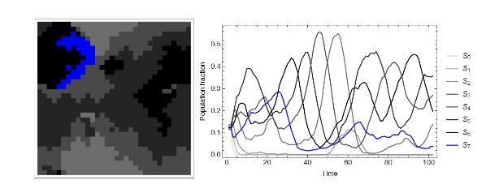
Future Work and Investigation
Application of the Minimax Algorithm
Experimental Evaluation Over an Extended Game
Develop a visualization of a reduced strategy space that highlights the backward induction in a
N-round game
Final Development of the Simulation and Interface
Introduce dynamic probability to require re-calculation of Nash Equilibrium over duration of the game

Slide 48
Questions?
Thank you so much for listening to this presentation!

